Slide 1
MOAB KHOTSONG MINE
FIRST ADOPTION MINE
Continuous Real-time Monitoring of
Airborne Pollutant Engineering Controls
by
Louise Kleynhans
30 July 2015

Slide 2
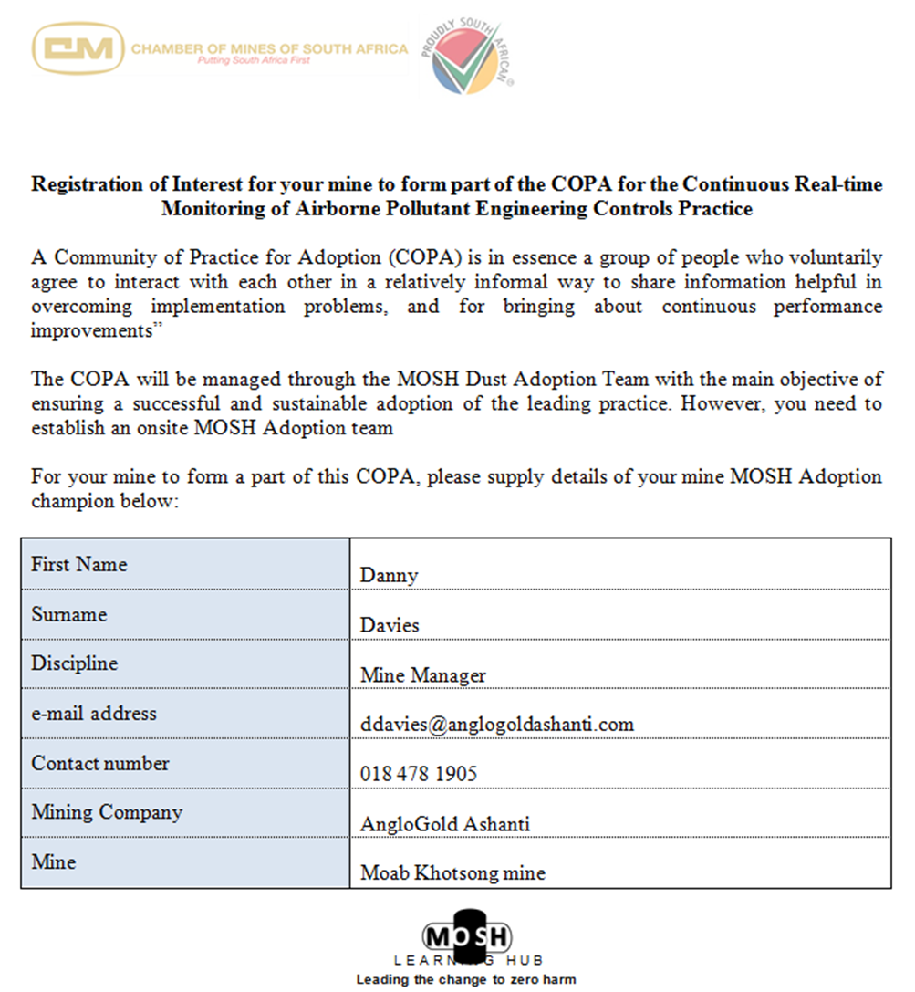
Where it all started………

Slide 3
Adoption Steps 1-3 (detail)
Step 1: Facilitate adoption decision
The risk review and adoption decision document signed by the senior manager on the mine.
Example
Step 2: Secure widespread support for adoption
Secure support of regional and mine-level union representatives.
Issue written mine-wide briefing note advising of decision to adopt.
Example
Step 3: Establish an effective adoption team
Appoint a champion and person to oversee customisation of behavioural plans
Training of above.
Provide team with LPAG.
Champ
Team Member

Slide 4
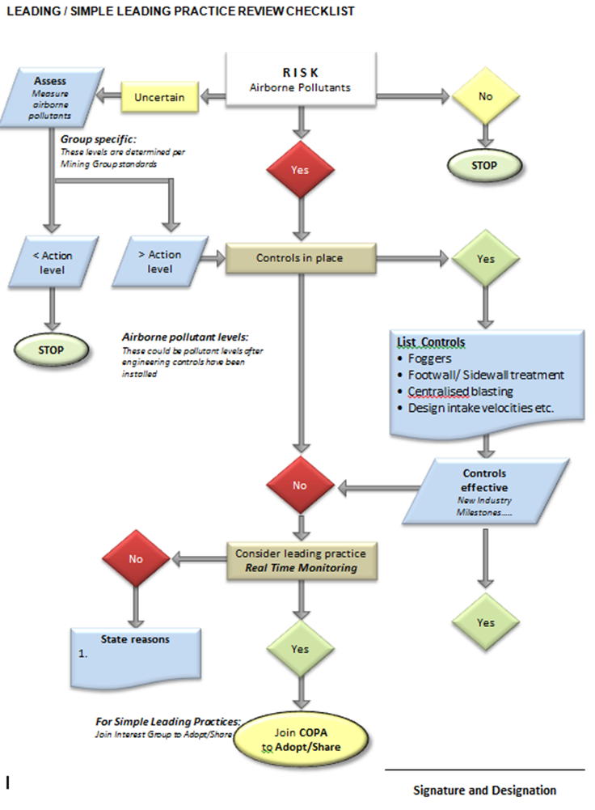

Slide 5
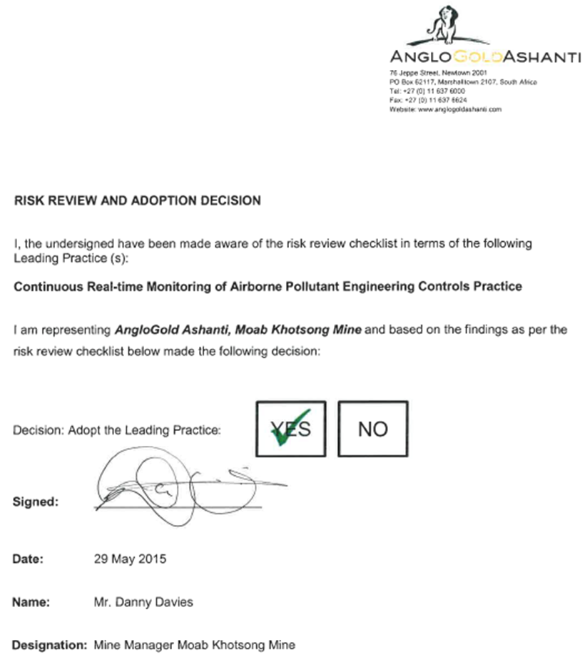

Slide 6
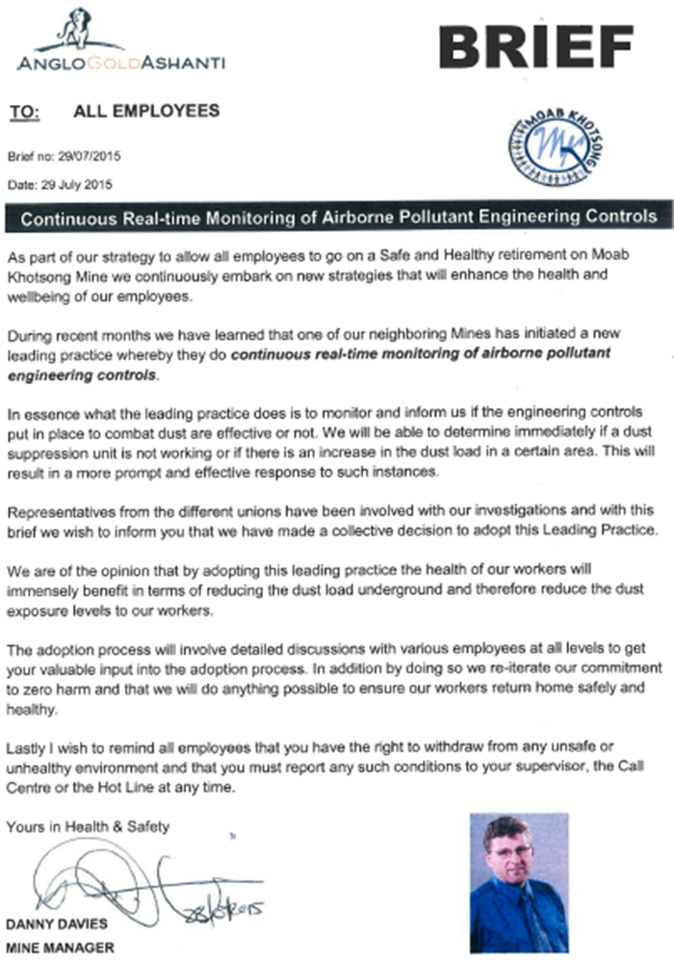

Slide 7
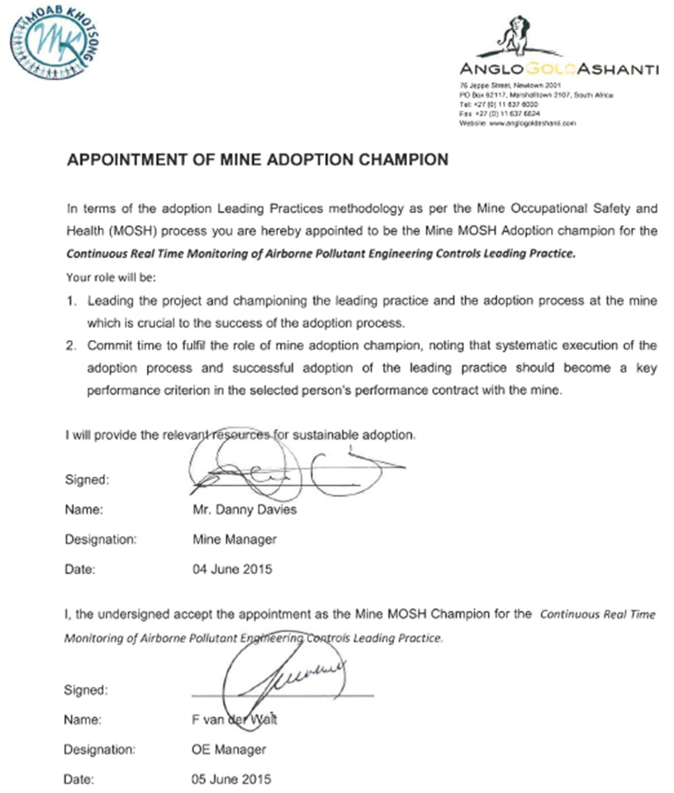

Slide 8
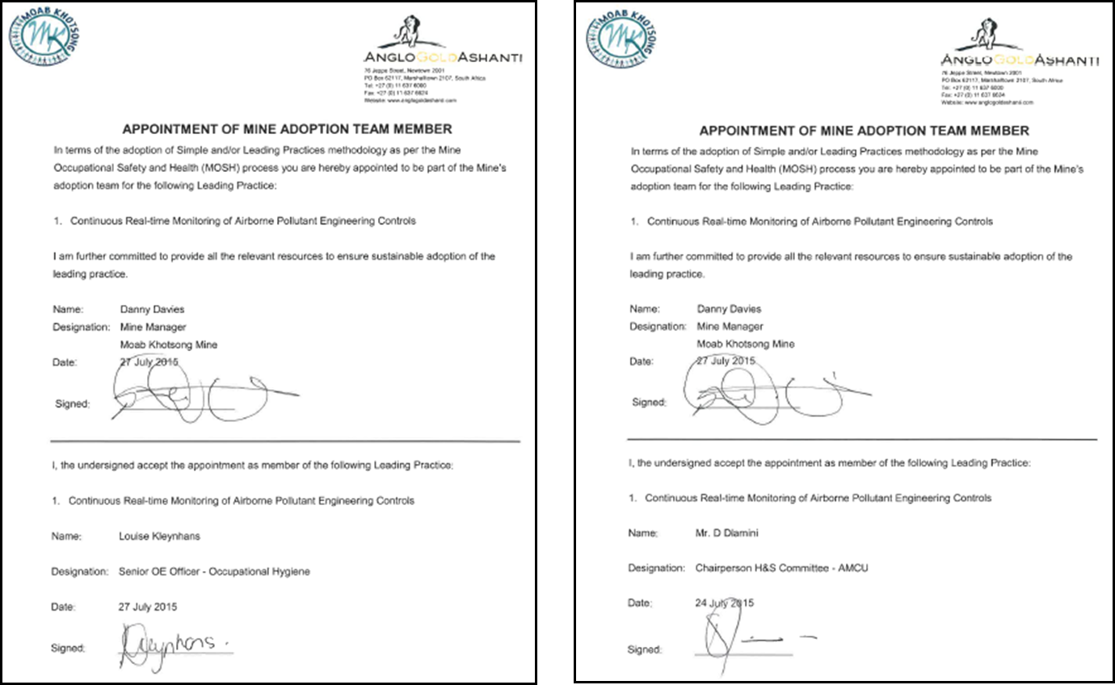

Slide 9
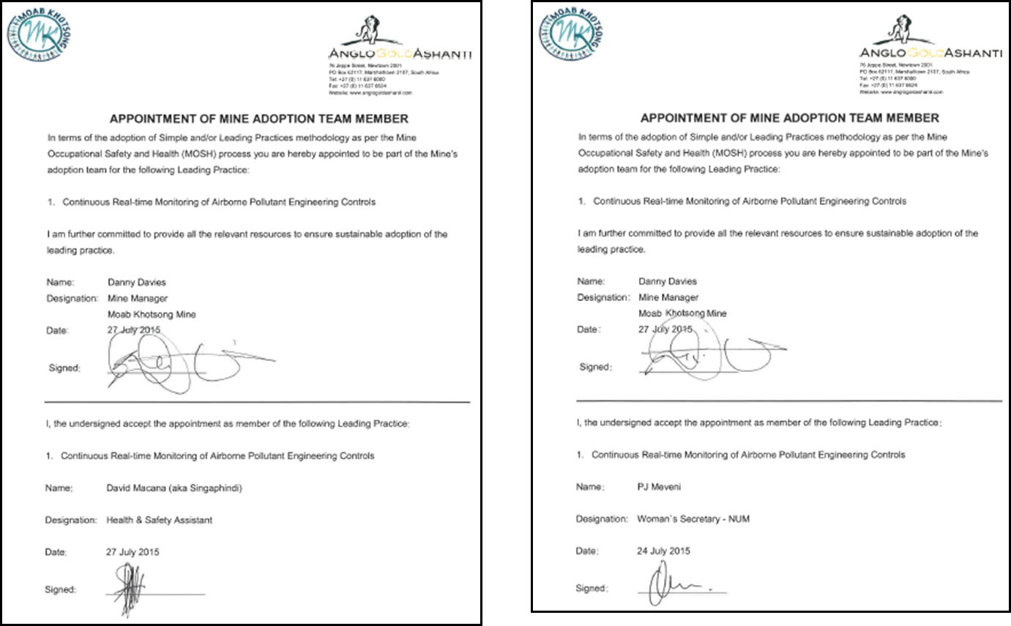
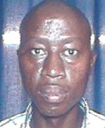

Slide 10
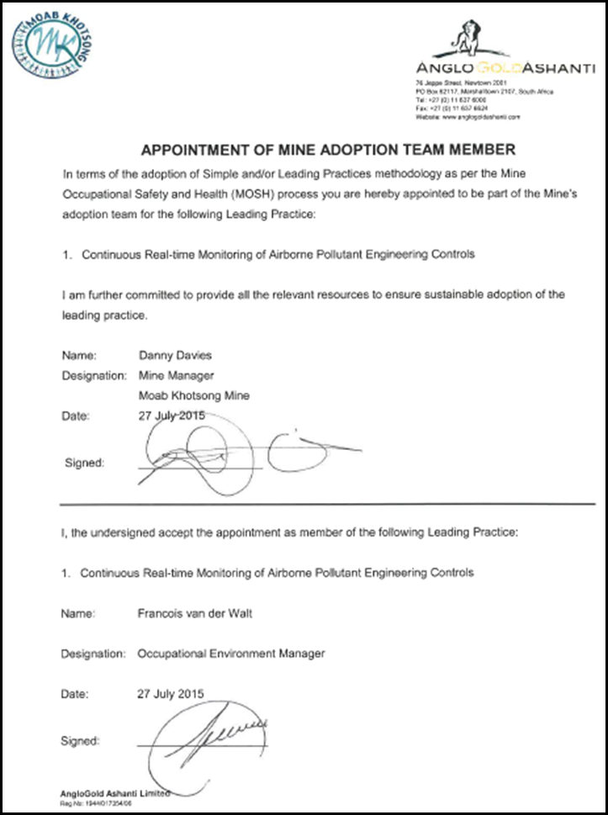

Slide 11
QUESTIONS?

