Slide 1
A view on mechanisation Declan Vogt
“Day of Learning”
on
“Value Added Drilling and Blasting Practices”

Slide 2
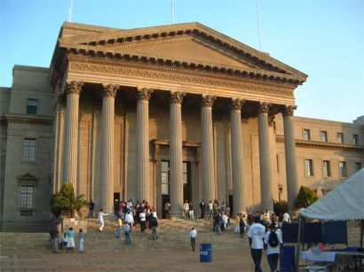
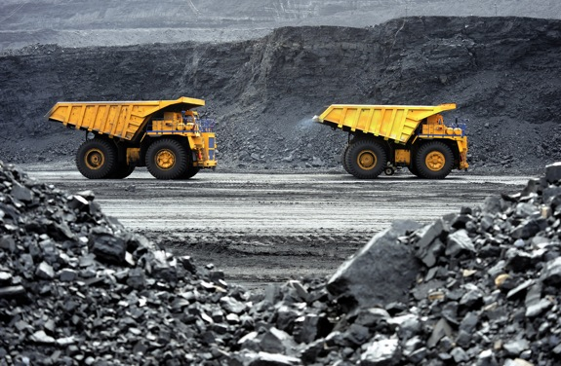
CMMS: Who are we?
Academic institution
Teaching
Research
Industry institution
Get mechanisation implemented in mines

Slide 3
What do we do?
Education
Systems thinking
Thought leadership
System
Process
People
Technology

Slide 4
Agenda
A vision of the future
Bringing it home
Some questions
Conclusion

Slide 5
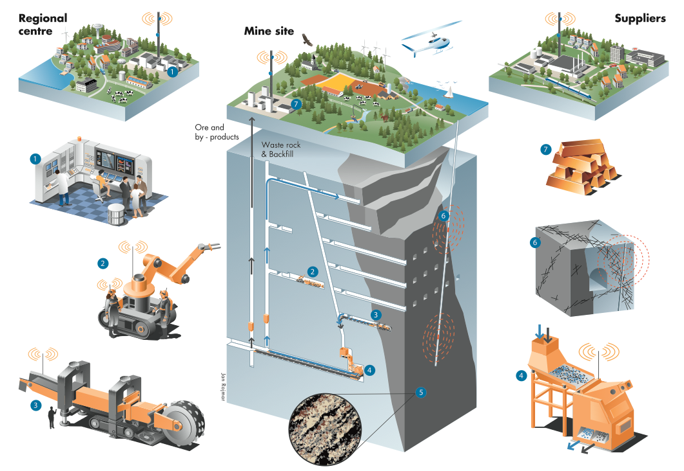
RockTech Centre – Sustainable Mine and Innovation for the Future

Slide 6
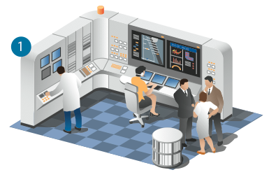
One control room
Information from:
Rock
Personnel
Machinery
Fine tuned process

Slide 7
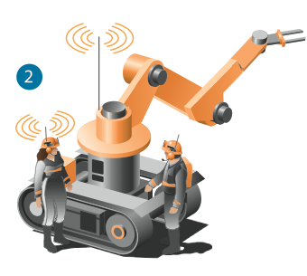
No human presence in production areas
All processes remote controlled or automated
Maintenance in safe areas
All electric – no diesel

Slide 8
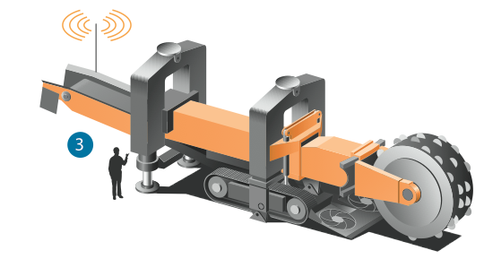
Continuous mechanical excavation
The future mine is a lean mine
Continuous process required

Slide 9
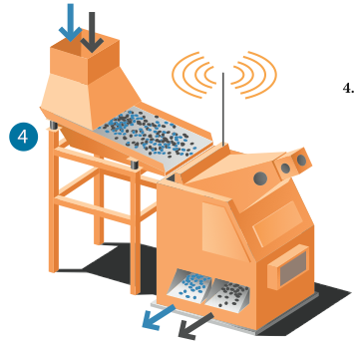
Pre-concentration
Barren rock is separated underground
Minimize energy
Minimize environmental impact

Slide 10
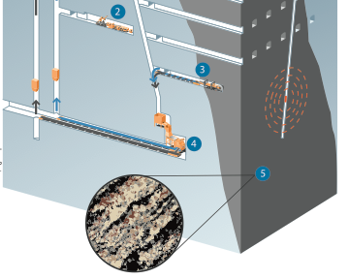
Resource characterization - mineralogy
Product control at face
Maximize in situ value

Slide 11
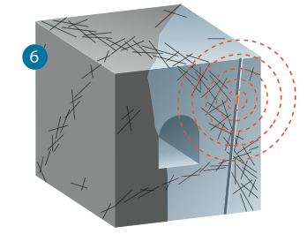
Resource characterization – structural control
Structures are mapped for process control

Slide 12
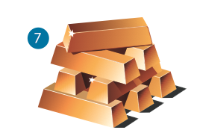
Final product
Waste rock becomes products
Metal manufactured on site
Greater value add contributes to richer social life

Slide 13
Agenda
A vision of the future
Bringing it home
Some questions
Conclusion

Slide 14
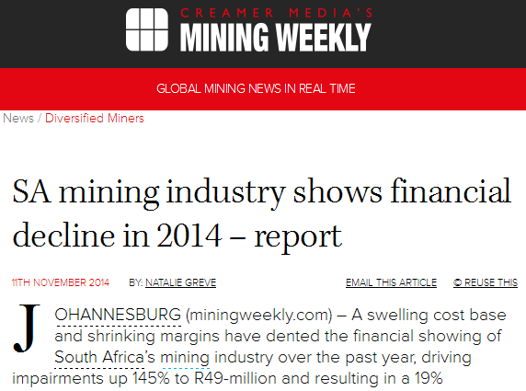
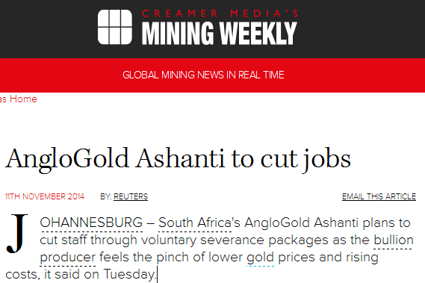
We are under pressure

Slide 15
Productivity is going down
PWC, Mining for efficiency, August 2014

Slide 16
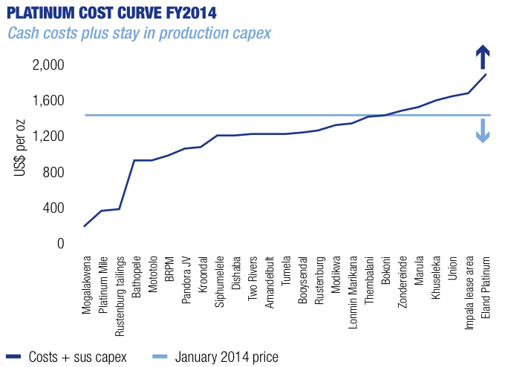
Platinum cost curve
Price
12/11/14
Baxter, Platinum state of the nation, January 2014

Slide 17
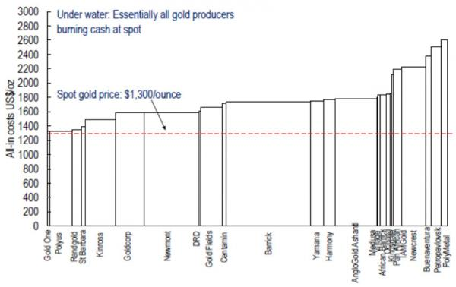
Gold cost curve
Citi reported in http://juniorgoldminerseeker.blogspot.com

Slide 18
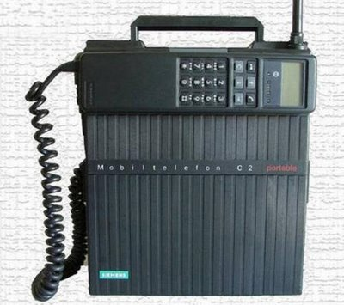
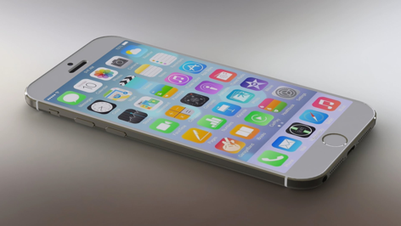
Modernise
Costs must come down
Safety must go up
Continuous production

Slide 19
It was done in coal
 | Conventional | CM
Tonnes per week | 10 000 | 15 000
Shifts per week | 17 | 11
Crew size/shift | 30-35 | 12-14
Tonnes/man shift | 17 | 100
For one coal section, historical conventional performance compared to current
continuous miner performance (pers comm.)

Slide 20
Agenda
A vision of the future
Bringing it home
Some questions
Conclusion

Slide 21
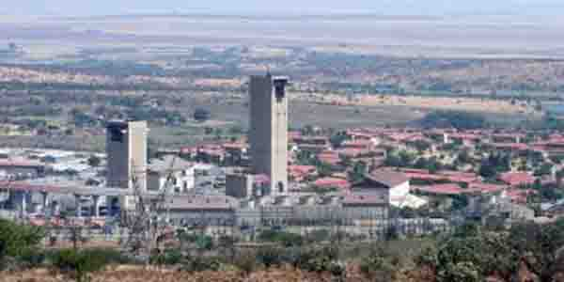
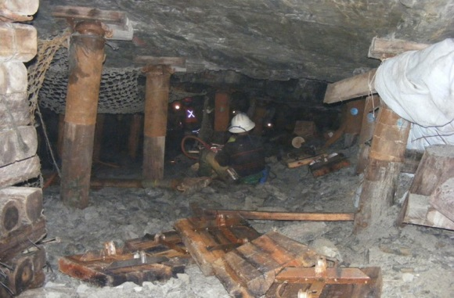
Can mechanisation work everywhere?
Old shafts
Size for access
Size for ventilation
Capital cost vs life of mine
Orebodies
Dip
Thickness
Hardness

Slide 22
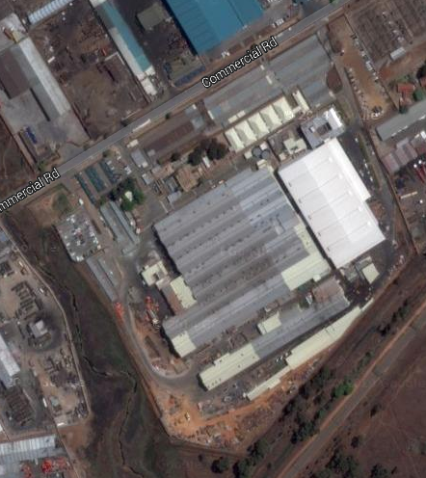
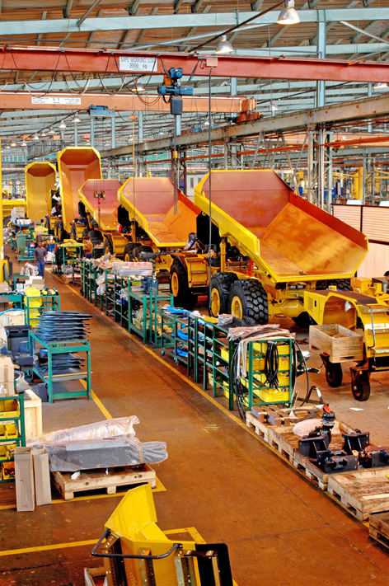
Can we make machines in SA?
Google Maps/JoyGlobal
Bell Equipment

Slide 23
Time horizons
Perceived high risk
High capital cost
System change

Slide 24
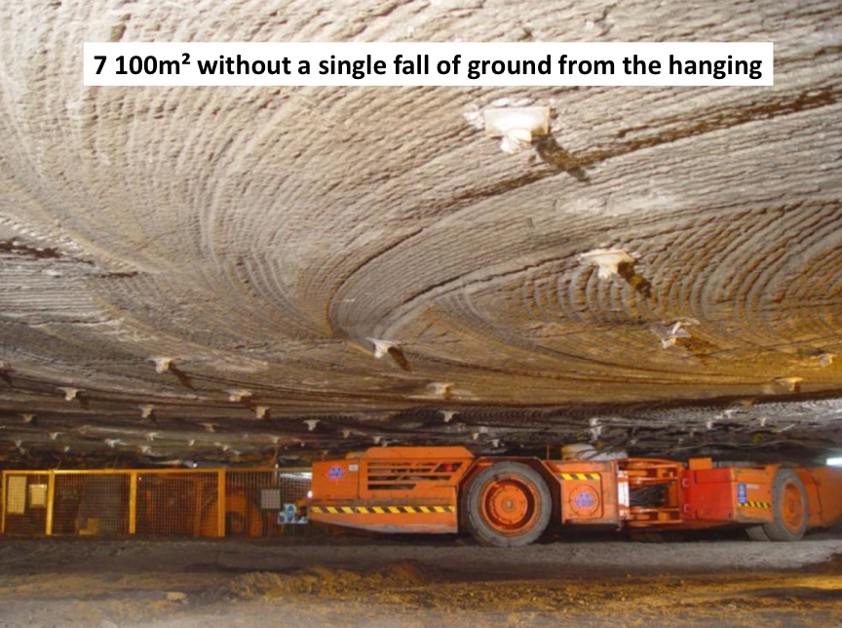
Explosives are pretty good, aren’t they
Source: Sandvik Mining and Construction

Slide 25
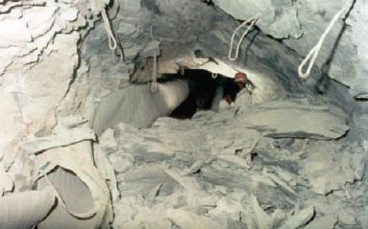
Does the blast not help in dissipating seismic activity?
Change from rapid to continuous
Damage
Re-entry times
Backfill
Stacey, Journal of SAIMM 112:8

Slide 26
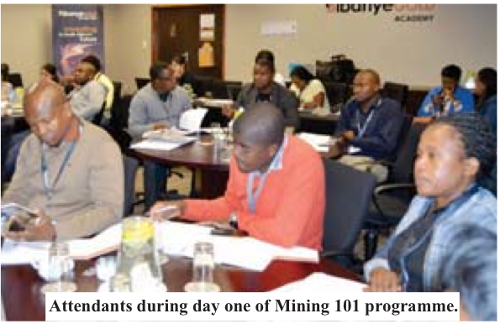
The labour issue
Jobs will move
People will be safer
Jobs will be more rewarding
Sibanye Gold

Slide 27
Agenda
A vision of the future
Bringing it home
Some questions
Conclusions

Slide 28
Conclusions
Mechanisation is coming
but not to all mines
In the meantime: drilling and blasting is part of a system
The system improves if the drilling and blasting is improved

Slide 29
Acknowledgements

Slide 30
?
declan.vogt@wits.ac.za

